Slide 1
SHOPCRAFTER PRO
“Empowering Your Shopping Journey: A Shopping Recommender”

Slide 2
Executive Summary
In the dynamic realm of online retail, our business seizes the opportunity to redefine the customer experience. With a vast array of products available, the need for personalized guidance is paramount. Leveraging advanced machine learning technology, our project's objective is to develop a state-of-the-art recommendation system that transforms the way customers discover and engage with products
By analyzing historical transactions, we aim to provide precise, tailored product suggestions, enhancing user satisfaction, fostering loyalty, and driving increased sales. Our goal is to set new standards in personalized e-commerce recommendations, creating a customer-centric online retail experience

Slide 3
Background
In the fast-paced world of online retail, the importance of a robust recommendation system cannot be overstated. The overwhelming range of products available to consumers creates a pressing need for a personalized and efficient shopping experience. Traditional models fall short in meeting these expectations. Our business recognizes this as a pivotal opportunity to redefine customer engagement. An advanced machine learning recommendation system is essential to exceed customer expectations, offering a seamless and enjoyable online shopping journey. By leveraging individual purchase behaviors, we aim to enhance overall satisfaction, foster loyalty, and boost our online retail platform's success in a market where personalized recommendations are a driving force.

Slide 4
Our Team
SUKHVEER SINGH
SOHAM BALAKRISHNA PALNITKAR
BUBESH KANNA DEVARAJ
Chief Data Officer
Chief Technology Officer
Chief Product Manager

Slide 5
Primary Stakeholders
External | Customer | The primary stakeholders are the customers of the online retail platform, whose satisfaction and engagement are crucial for the success of the recommendation system.
 | Business Owners | Business owners are directly invested in the success of the recommendation system as it contributes to overall business growth and success.
Internal | Data Scientists | The data scientists are responsible for developing, implementing, and refining the recommendation system, making them essential stakeholders.
 | Marketing Team | Marketing team plays a critical role in leveraging the recommendation system to promote targeted products, impacting customer engagement and conversion rates.

Slide 6
Scope of the Project
Objective of the Project
The project encompasses acquiring and preprocessing data from the UCI Machine Learning Repository, featuring the creation of customer behavior-driven features, and developing a machine learning-based recommendation system
The project aims to deliver an advanced recommendation system for the online retail platform, enhancing user experience and boosting sales through personalized product suggestions. Utilizing a machine learning model, the objective is to optimize the accuracy of recommendations based on customer preferences and transactions. Continuous improvement mechanisms, including a feedback loop and performance monitoring, will be established, and comprehensive documentation and knowledge transfer sessions will ensure long-term sustainability and understanding among relevant teams

Slide 7
Timeline
Model Selection and Training
Deployment
Project Initiation
NOV 2023
MAY 2024
SEP 2023
JAN 2024
JUN 2024
Data Collection and Preprocessing
Integration & Testing
Define project scope, objectives, and success criteria
Choose the appropriate ML algorithm, Train the selected model on data
Deploy and Monitor system performance and user interactions
Acquire, Explore and preprocess the dataset
Integration with Online Platform and User Acceptance Testing

Slide 8
Development Strategy
Why collaborative filtering?
Works well for sparse matrices with many products/users
Doesn't require detailed product info
Simpler & more scalable vs content-based filtering
Core analysis steps:
Create user-item matrix
Calculate cosine similarity between users
Recommend top products liked by similar users

Slide 9
Benefits
Leverages user behavior data
Identifies patterns between users
Provides personalized recommendations
Scalable
Driven by data
Personalized recommendations
Does not rely on complex product attributes

Slide 10
Development Details
Data:
Source: Online retail transaction dataset
Fields used: StockCode, Description, CustomerID, Quantity
Preprocessing:
Removed missing CustomerIDs
Pivoted data into user-item matrix
Converted to binary matrix

Slide 11
Contnd..
Modeling:
Calculated cosine similarity between users
Recommended top products liked by similar users
Methods used:
Collaborative filtering
Matrix factorization
Cosine similarity

Slide 12
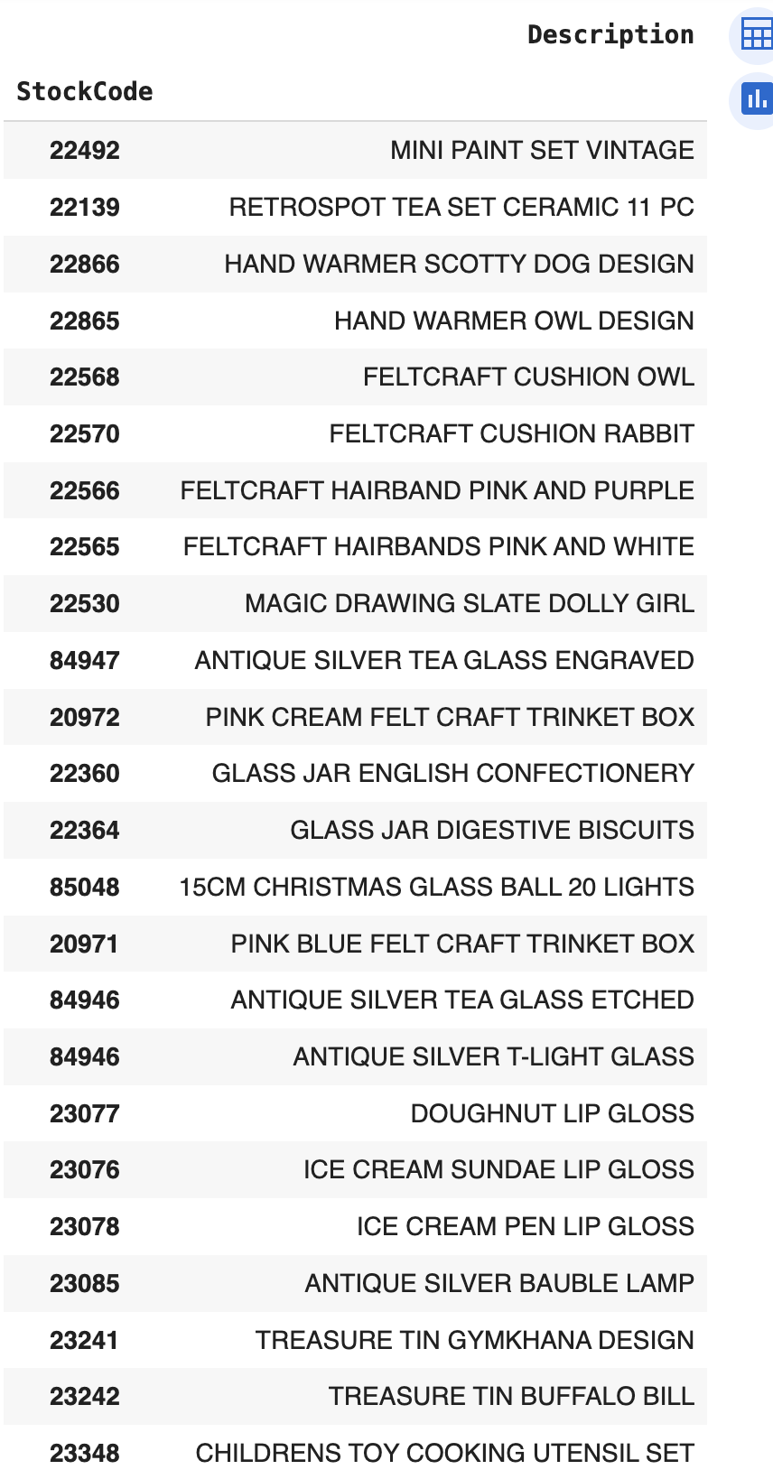
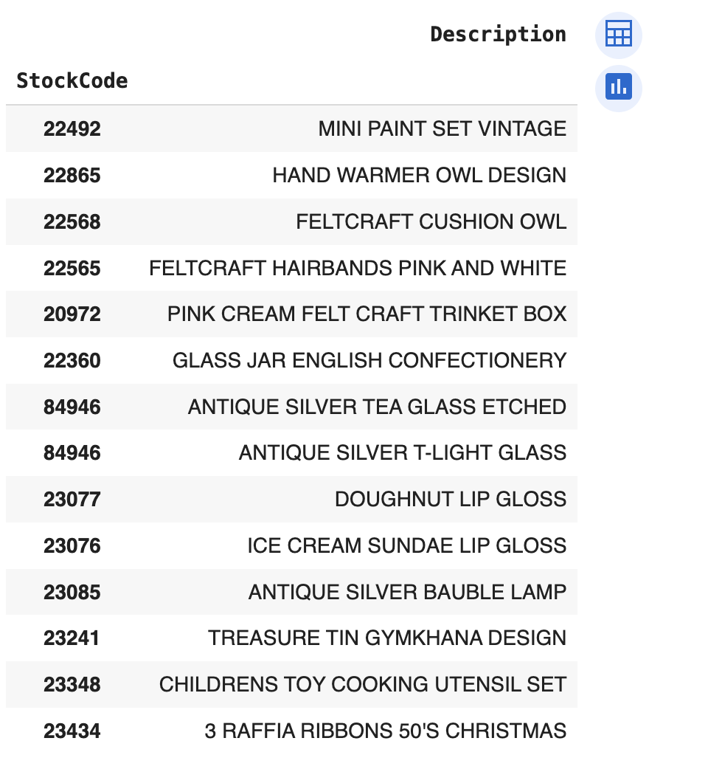

Results:
Our Recommendation system will predict the relevant products for customers based on their shopping history
Output : Recommended Products
Input : The Products Customer Bought
Model Processing the Output

Slide 13
Socialization & Distribution
Goals:
Showcase value of recommendations
Optimize inventory
Drive user engagement
Channels:
Web interface for personalized recommendations
Daily reports on top products overall & by segment
Mobile app for on-the-go recommendations
Stakeholder meetings to demonstrate value
Ongoing user feedback loops

Slide 14
Key Initiatives
Personalized dashboard for customers
Inventory optimization reports
Mobile app with push notifications
Stakeholder demos
User surveys and feedback

Slide 15
Distribution summary:
Multi-channel distribution strategy
Focus on value demonstration and user engagement
Combination of proactive and user-driven feedback
Iterative system refinement based on user input

Slide 16
cont..
Implementation:
Share recommendations via dashboards
Build mobile app for personalized suggestions
Provide recommendations through various channels
Optimization:
Collect user feedback
Refine recommendations based on input
Continually improve relevance

Slide 17
Conclusion
Approaches Tested:
Regression model
KNN based on quantity sold
Collaborative filtering
Performance:
Regression had high error, low R^2
KNN only used quantity, not user data
Collaborative filtering optimized for user patterns

Slide 18
Key Takeaways
Collaborative filtering outperformed other models
Leverages user behavior data effectively
Provides personalized recommendations Finds patterns between similar users

Slide 19
Any Questions ?

Slide 20
Thank You

